Slide 1


AI and Accessibility:
the Good,
the Bad,
and the Bollocks
Léonie Watson

Slide 2

Never mind

Slide 3
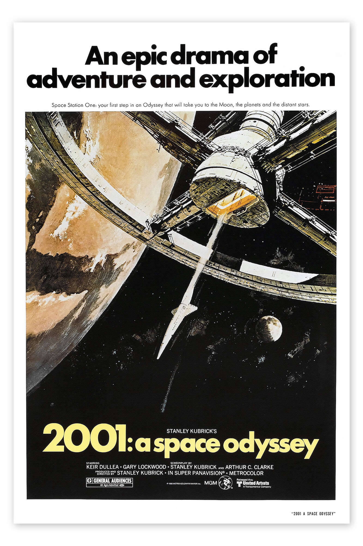

General AI

Slide 4
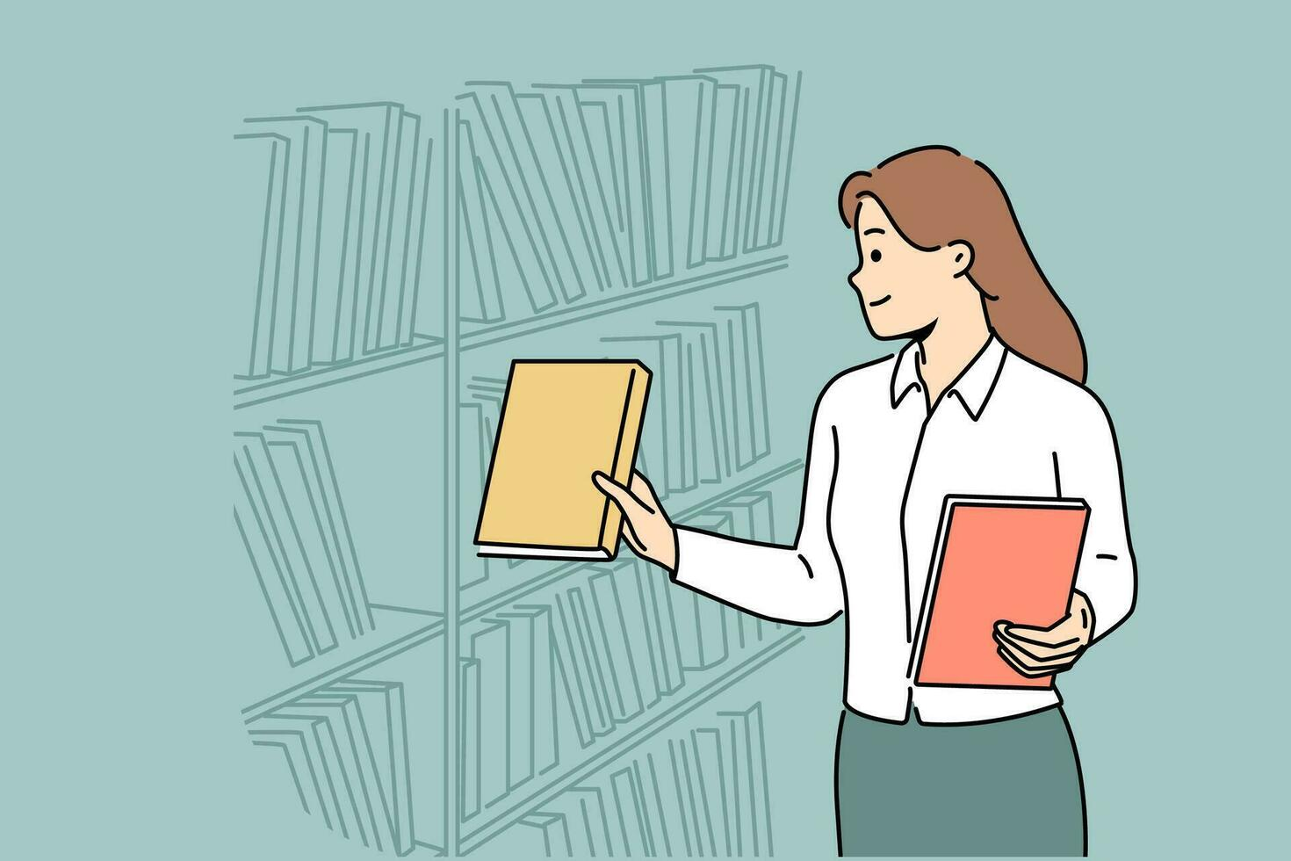
Discriminative AI

Slide 5
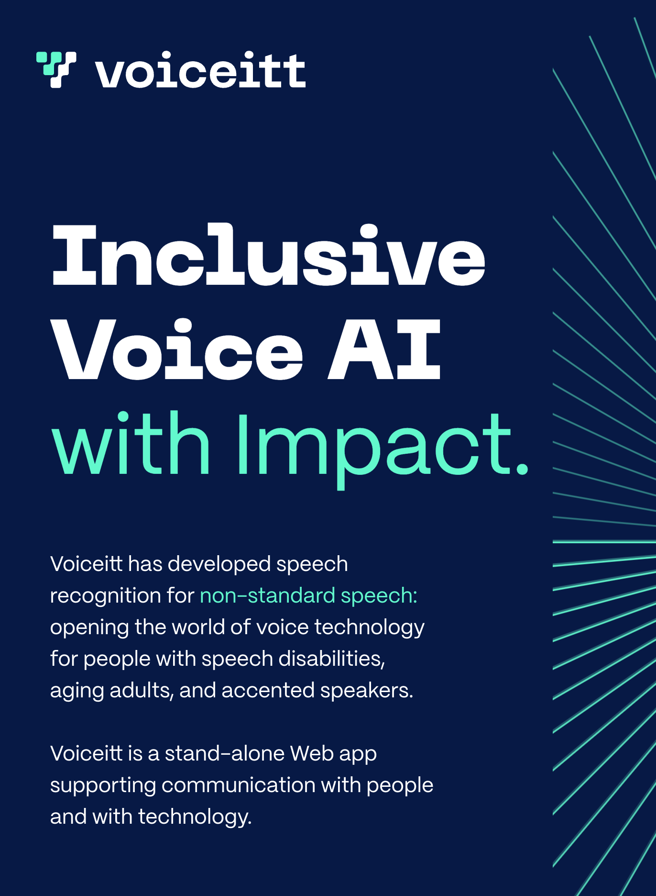
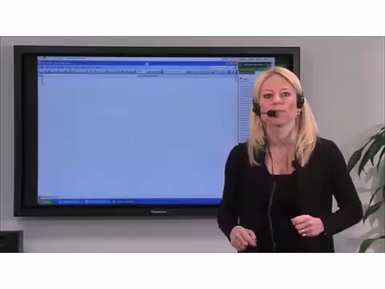
Speech recognition

Slide 6
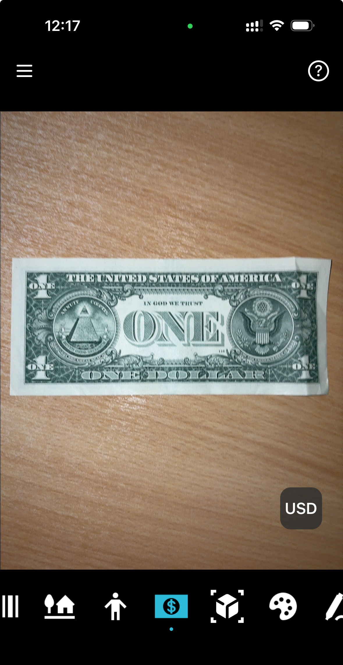
Object recognition

Slide 7

Face recognition

Slide 8
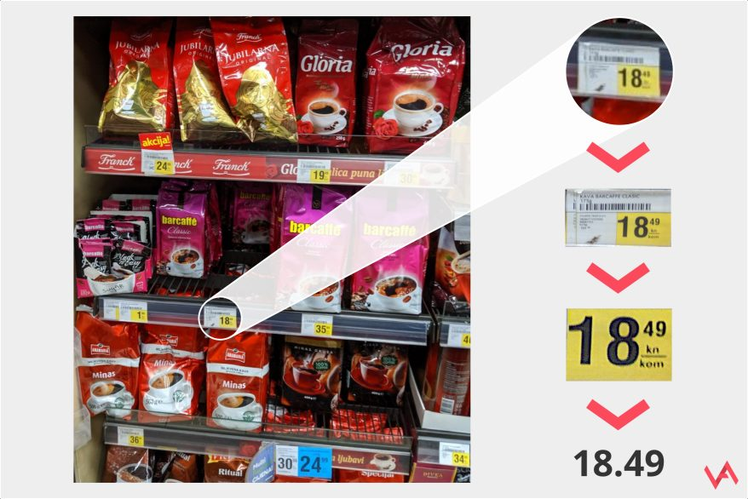
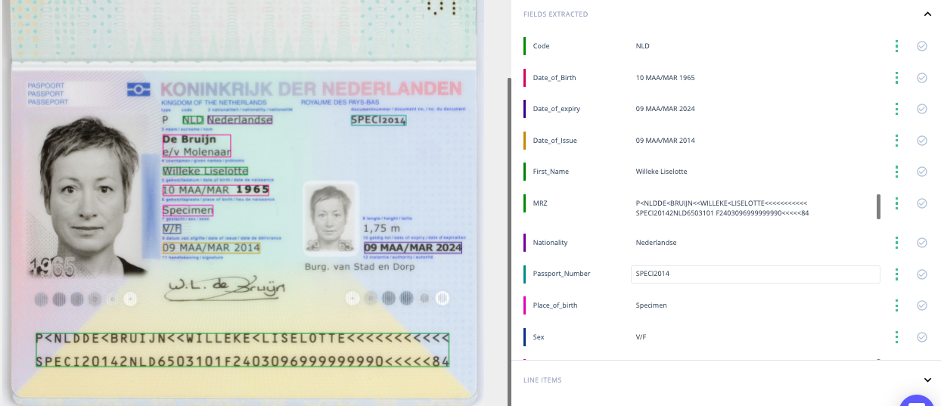
Character recognition

Slide 9
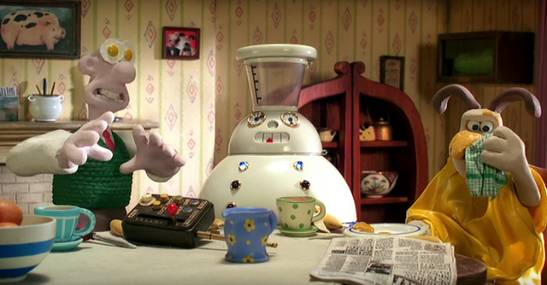
Generative AI

Slide 10
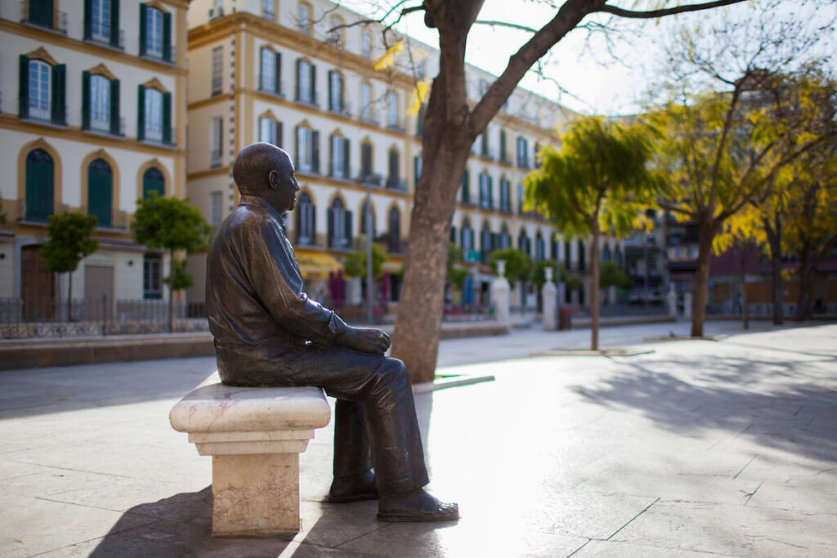
Text generation

Slide 11
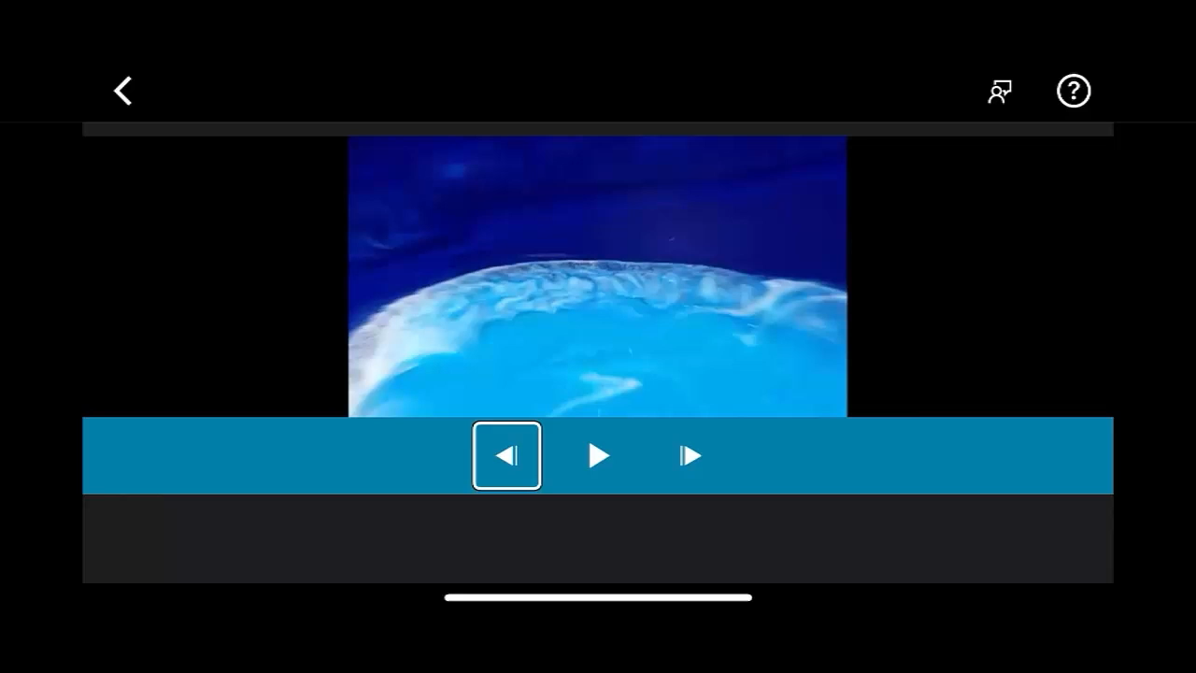
Video description

Slide 12
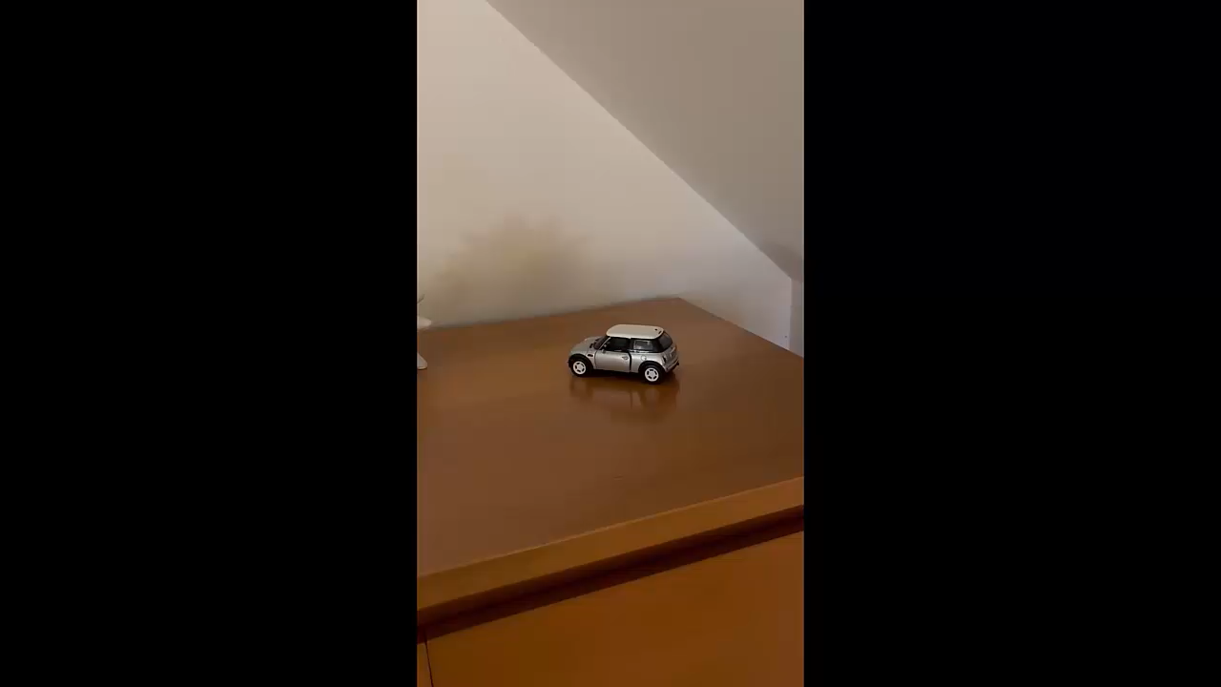
Realtime description
fantasai <fantasai@inkedblade.net>, board@w3.org

Slide 13
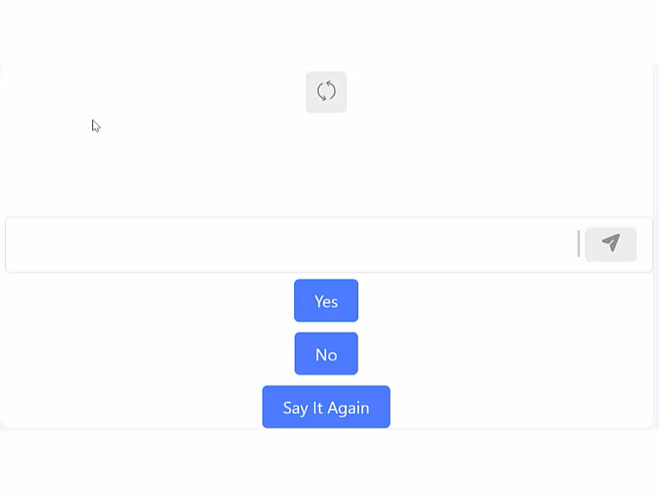
Text + speech generation
https://easyspeak-aac.com

Slide 14
Speech generation

Slide 15
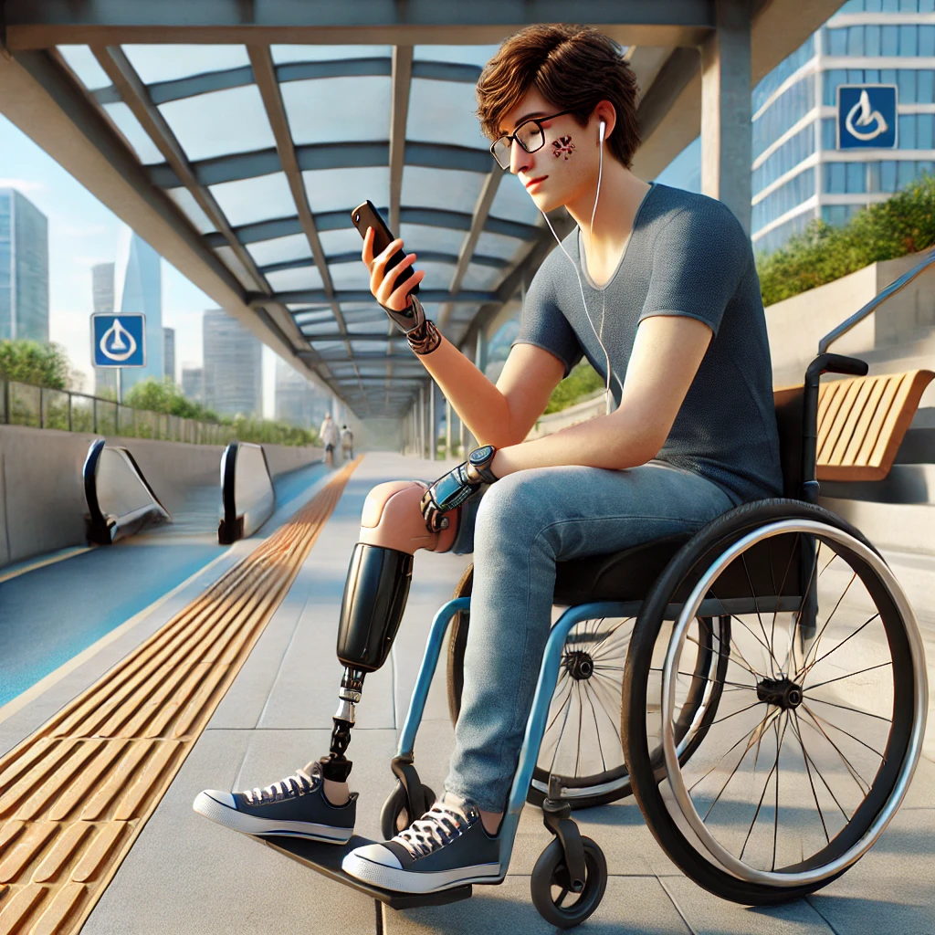
Image generation

Slide 16
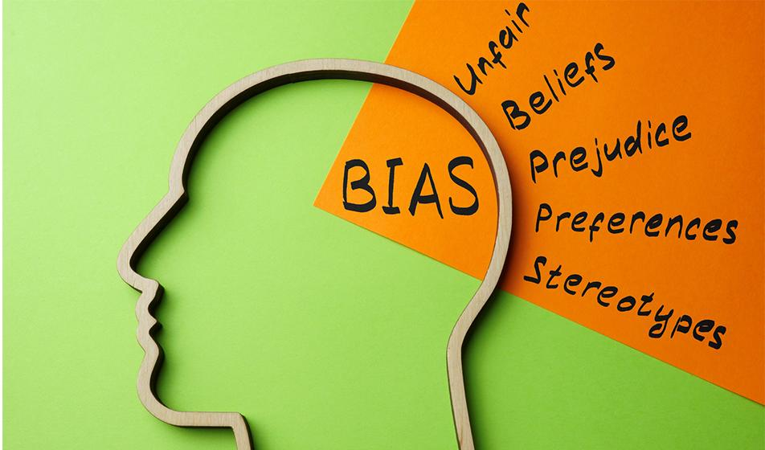
Bias

Slide 17
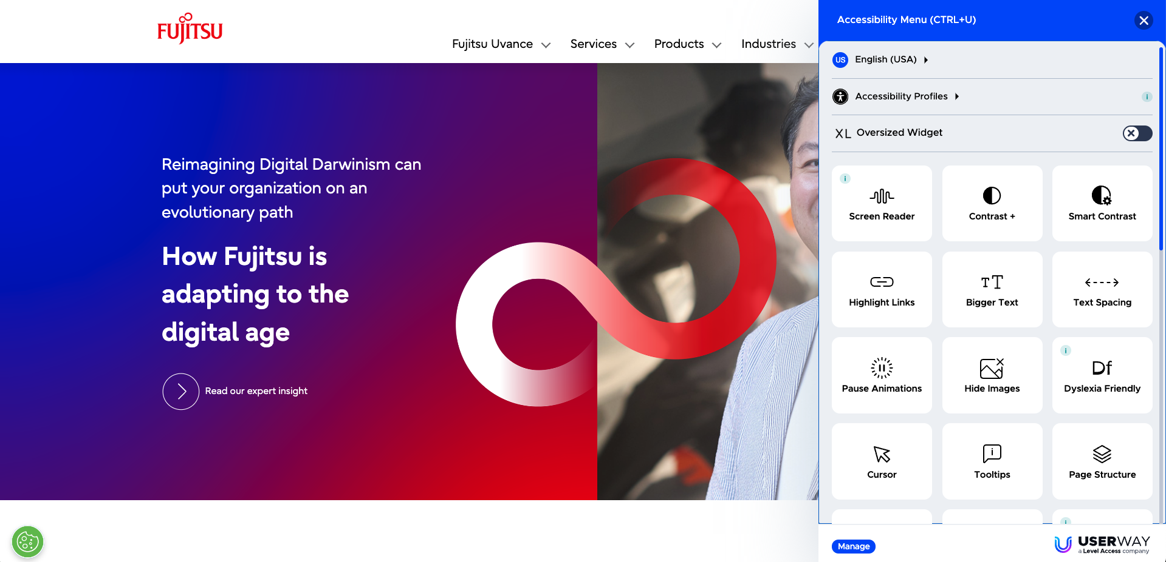
Overlays

Slide 18

Promises

Slide 19
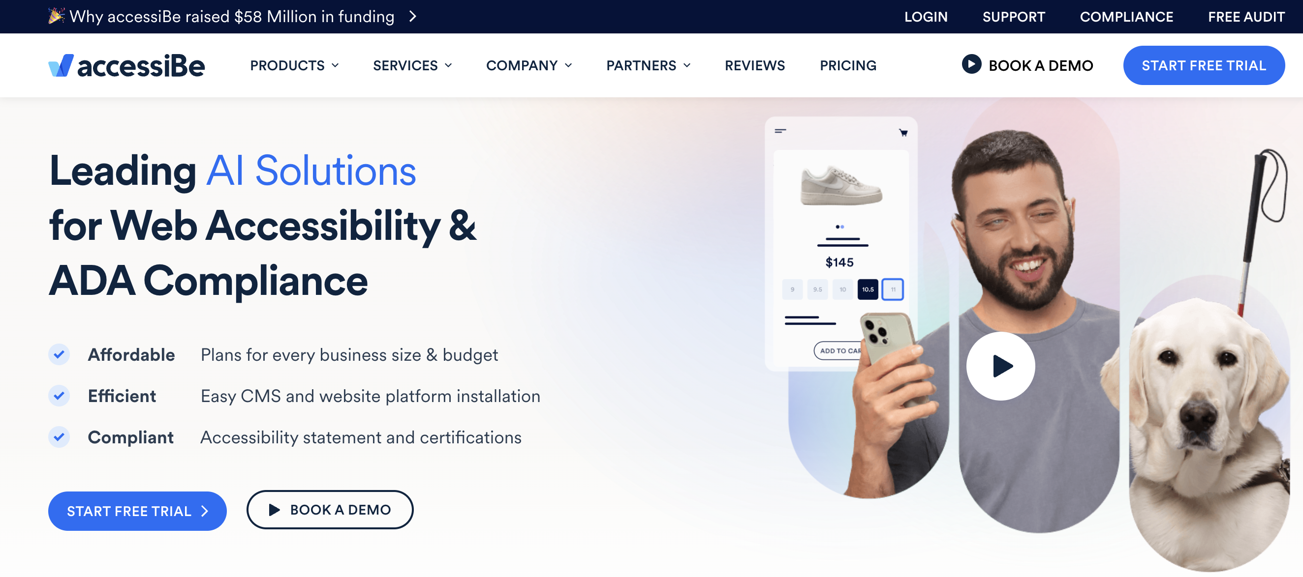




AccessiBe

Slide 20
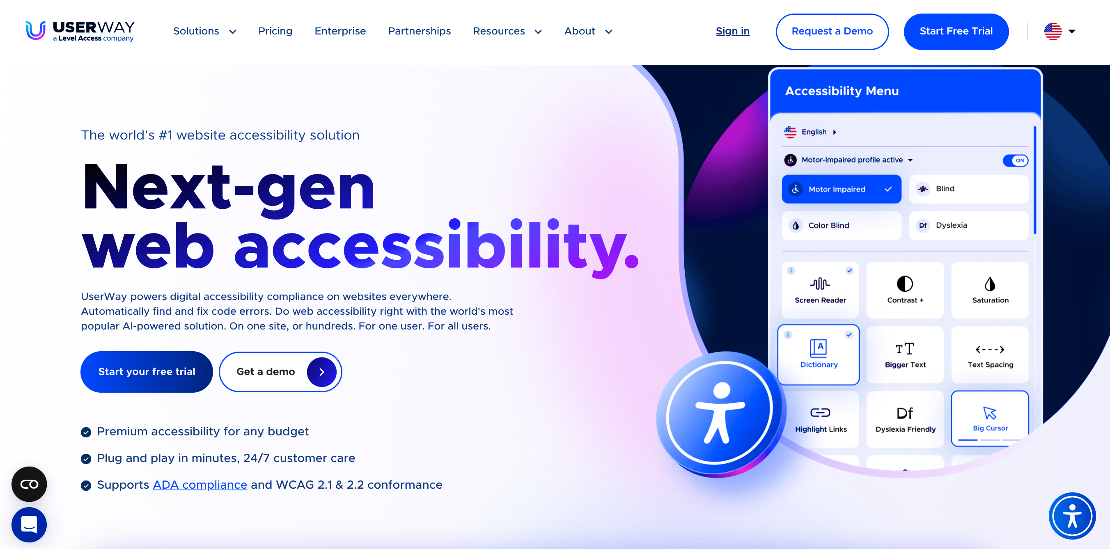
UserWay

Slide 21
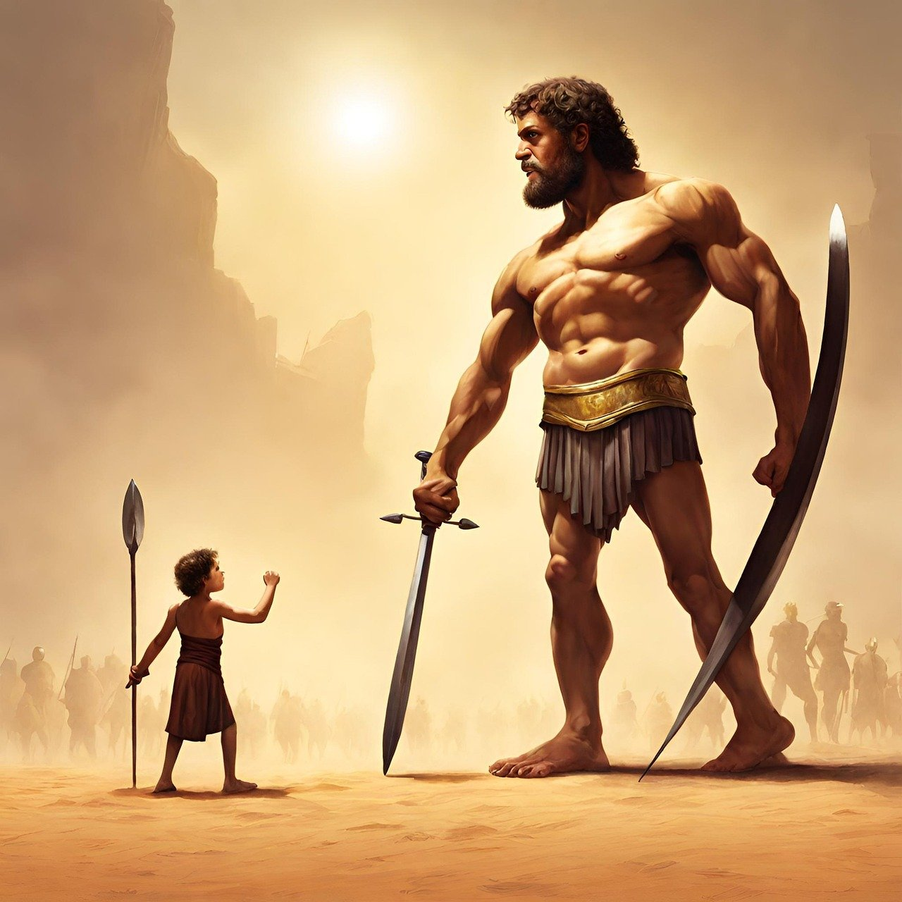
Tactics

Slide 22
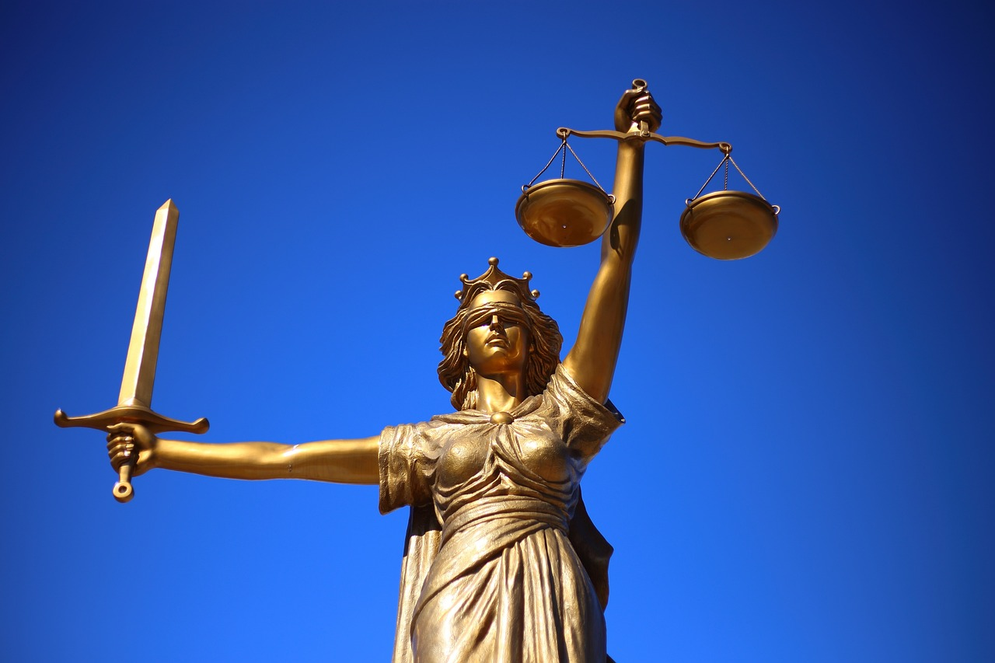
Results

Slide 23
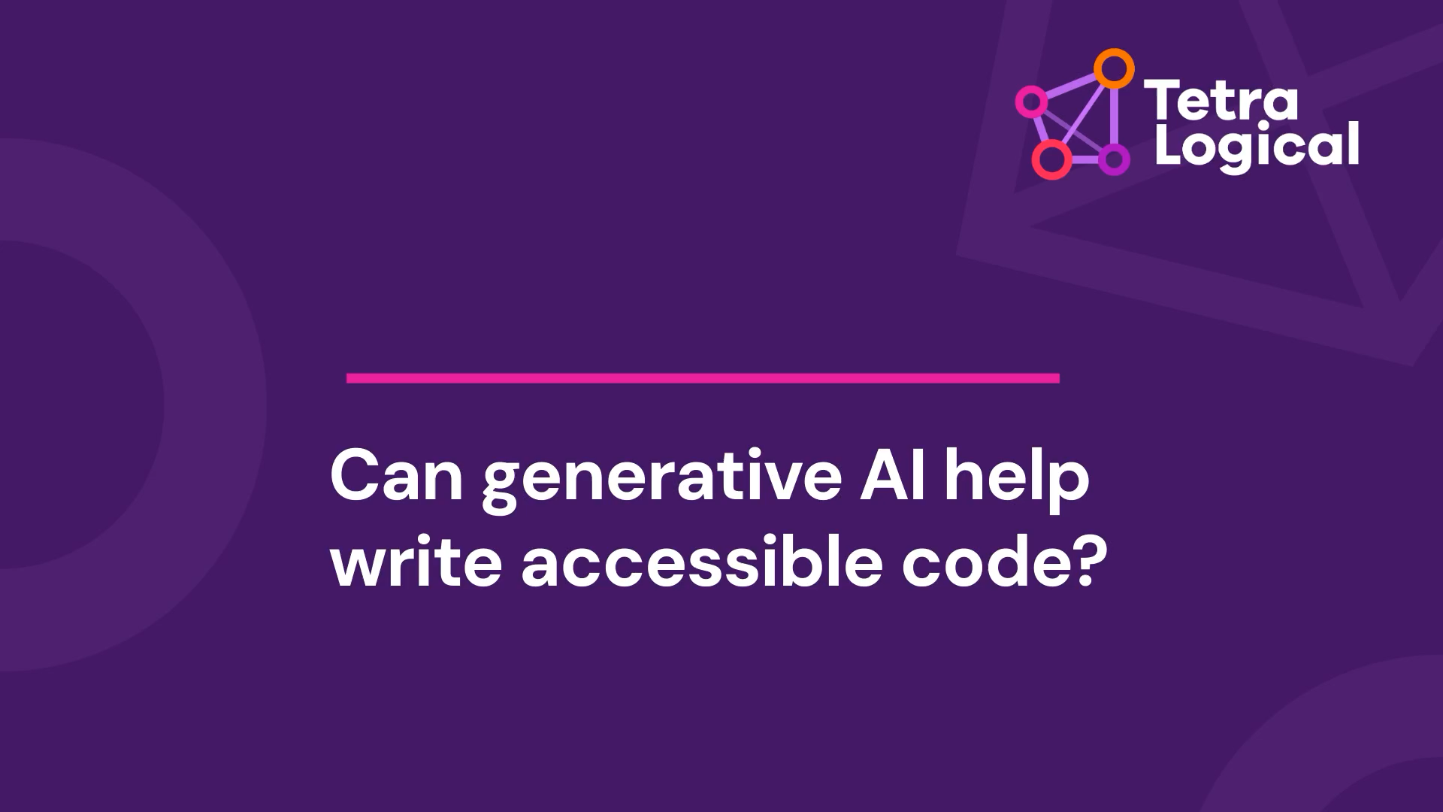
Code generation
*** Shortened blog post video ***

Slide 24
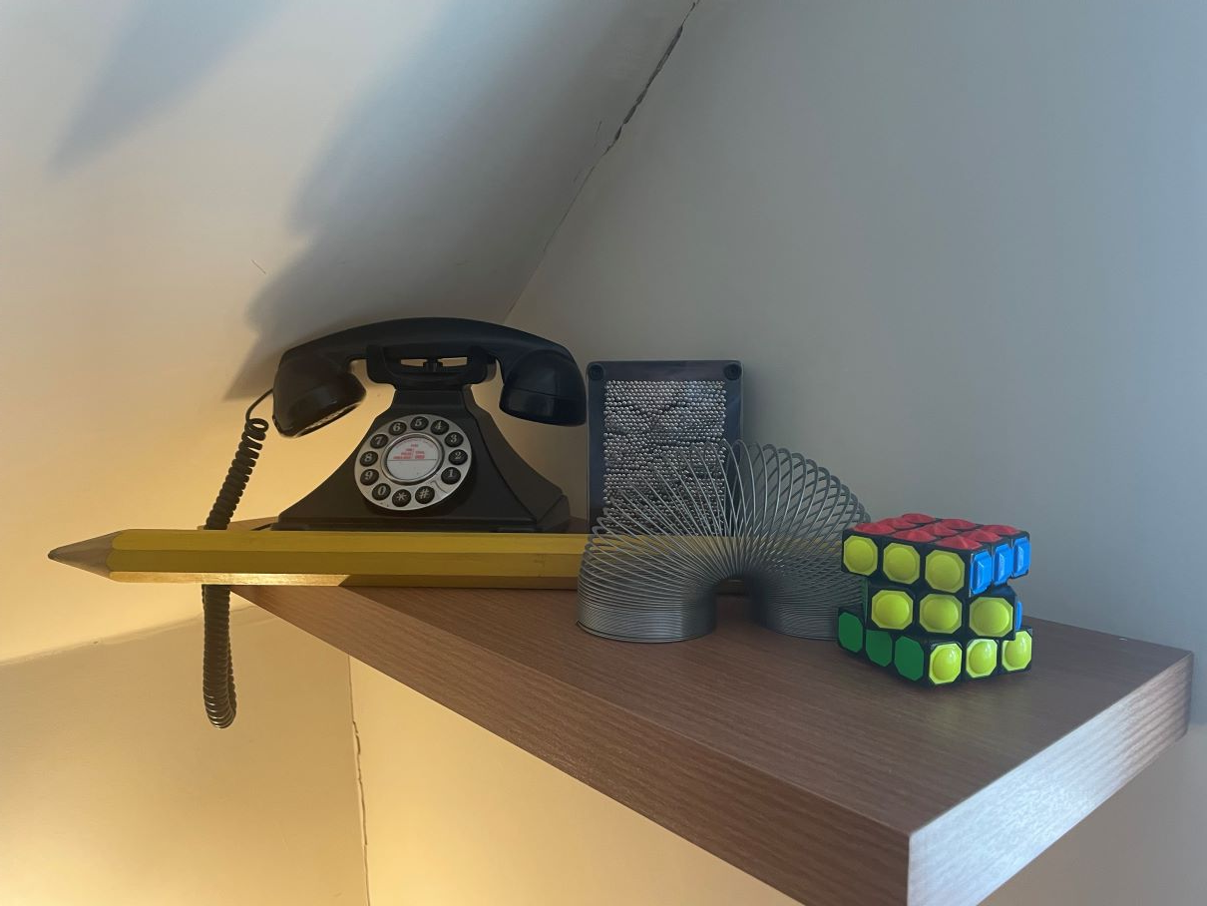
Hallucinations

Slide 25




Thank you

